Slide 1
Learning Objectives
01
Dimensionality Reduction Techniques
02
Curse of Dimensionality
03
Application of Principal Component Analysis
04
Application of Discriminant Component Analysis

Slide 2
Dimensionality
Dimensionality refers to the number of features, attributes or variables that describe each data point in a dataset
ID | Age | Income | Experience
1 | 54 | 4000000 | 25
2 | 43 | 2000000 | 20
The number of columns in a dataset is the dimensionality of the dataset. For the dataset given above, the dimensionality is 4

Slide 3
Curse of Dimensionality
The curse of dimensionality refers to the various challenges and phenomena that arise when analyzing and organizing high-dimensional data spaces.
Problems due to high dimensionality:
Increased data sparsity
Increased computational cost
Increased risk of overfitting in Machine Learning Models
Difficulty in visualisation
Feature redundancy and irrelevance

Slide 4
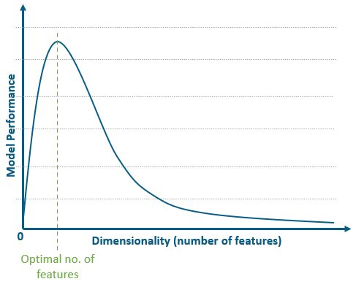
Curse of Dimensionality
Increased data sparsity:
A phenomenon in high-dimensional spaces where the volume of the space grows exponentially with the number of dimensions, causing a fixed number of data points to become increasingly spread out and occupy a proportionally smaller fraction of the total space.
Increased computational cost:
The escalation in the resources (time and memory) required by algorithms as the number of dimensions in the data increases, often exhibiting polynomial or exponential growth in complexity.
Increased risk of overfitting in Machine Learning Models:
A heightened susceptibility of machine learning models to learn noise and specificities of the training data rather than the underlying patterns when dealing with many features relative to the number of samples, leading to poor generalization to unseen data.
Source: https://www.shiksha.com/online-courses/articles/curse-of-dimensionality/

Slide 5
Curse of Dimensionality
Difficulty in visualisation:
The inherent limitation in representing and perceiving data with more than three dimensions within the human visual system, hindering intuitive exploration and understanding of high-dimensional datasets.
Feature redundancy and irrelevance:
The presence of features in a dataset that either provide duplicative information already contained in other features (redundancy) or have no meaningful relationship with the variable of interest (irrelevance), both contributing to increased dimensionality without adding useful signal.

Slide 6
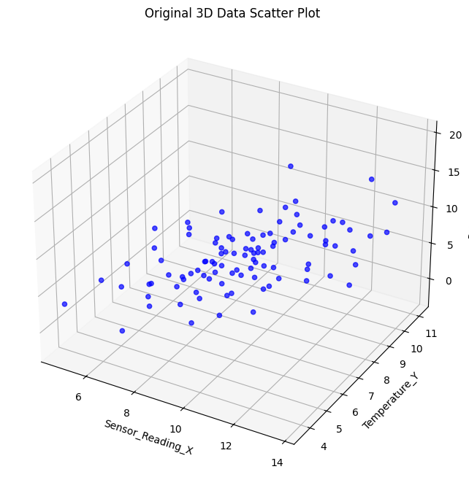
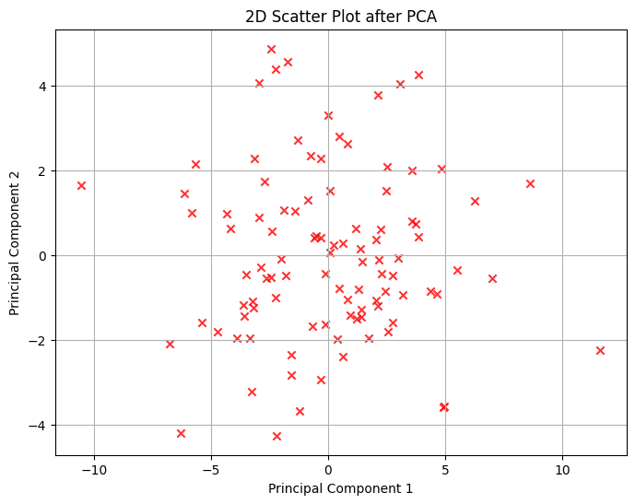
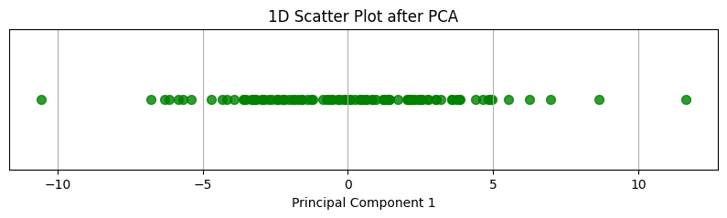
What is Dimensionality Reduction
Dimensionality Reduction is the process of transforming high-dimensional data into a lower-dimensional representation while preserving the essential characteristics and underlying structure of the original data. Fundamentally, it aims to reduce the number of random variables (features or dimensions) under consideration by deriving a smaller set of principal variables or features.
The primary goal of dimensionality reduction is to strike a balance between simplicity and information retention.

Slide 7
Why is Dimensionality Reduction Important?
Improved Model Performance Fewer features can drastically speed up training and prediction while often improving accuracy by removing noise and irrelevant information.
Reduced Storage Requirements Lower dimensionality directly translates to less memory needed for data storage, offering efficiency gains.
Enhanced Data Visualization and Interpretability Reducing dimensions to 2 or 3 allows for direct visualization, aiding in understanding data structure and patterns.
Noise Reduction Dimensionality reduction methods can effectively filter out noise, allowing models to focus on the crucial underlying signals.

Slide 8
Types of Dimensionality Reduction
Feature Selection
Involves identifying and selecting a subset of the original features that are most relevant and informative for the task at hand. The original features are maintained, but less important or redundant ones are discarded.
The resulting features are a direct subset of the original features.
Focuses on identifying the most impactful existing variables. Eg. Variance Thresholding
Feature Extraction
Involves transforming the original features into a new set of lower-dimensional features. These new features are combinations or projections of the original variables, aiming to capture the most significant variance in a more compact form.
The resulting features are new variables, not simply a selection of the original ones.
Aims to create more informative and less redundant representations. Eg. PCA

Slide 9
Feature Selection V/S Feature Extraction
Feature Selection | Feature Extraction
Selects a subset of the original features. | Creates new, lower-dimensional features from the original ones.
A subset of the original features. | New features (often combinations/transformations of originals).
Discards irrelevant/redundant original features. | Transforms original features to capture most variance.
Generally higher interpretability, as original features are retained. | Can be lower interpretability, as new features may lack direct meaning.
Variance Thresholding, Correlation, RFE, Tree-based Importance, Chi-squared test. | PCA, LDA, t-SNE, Autoencoders, HOG, TF-IDF, MFCCs.

Slide 10
Advantages and Disadvantages
Feature Selection
Feature Extraction
Advantages | Disadvantages
Easy to interpret the selected features | Finding the optimal subset can be computationally expensive
Can improve model interpretability. | May lose some information by discarding features.
Advantages | Disadvantages
Can capture the most important variance in data | The new feature can be less interpretable than original ones
Can handle multicollinearity | May lose some information in the transformation

Slide 11
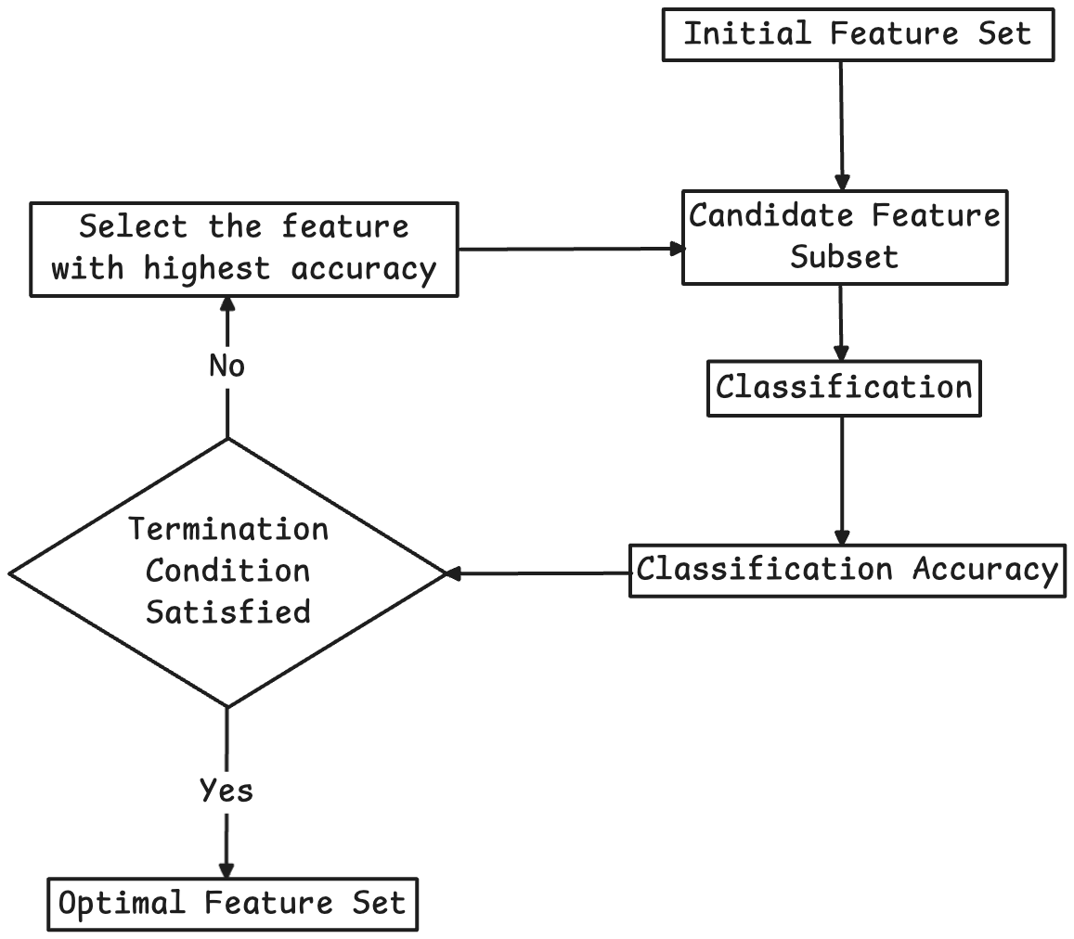
Feature Selection Techniques
Filter Models Evaluate the relevance of features based on their intrinsic properties, independent of any specific learning algorithm. Eg. Variance Thresholding
Wrapper Models Evaluate subsets of features by training and evaluating a specific machine learning model on them. Eg. Forward Selection
Embedding Models Feature selection is performed as part of the model training process. Eg. L1 Regularization

Slide 12
Feature Extraction Techniques
Principal Component Analysis A linear dimensionality reduction technique that finds orthogonal principal components (directions of maximum variance) in the data. The goal is to project the data onto these principal components, retaining the most variance in the fewest dimensions.
Linear Discriminant Analysis (LDA) A supervised dimensionality reduction technique that aims to find a linear combination of features that best separates different classes. It’s goal is to maximize the separation between class means while minimizing the variance within each class.
Non-linear Dimensionality Reduction Techniques Techniques that can capture non-linear relationships in the data. They are more effective for complex, non-linearly separable data. But are more computationally expensive and the resulting lower-dimensional space can be difficult to interpret.

Slide 13
Factors to consider to choose the right technique
Nature of the data (linear vs. non-linear relationships):
The underlying structure of your data is crucial. If variables have direct, straight-line relationships, linear techniques like PCA work well. For more complex, curved relationships, non-linear methods such as t-SNE, UMAP, or kernel PCA are necessary to capture the true data structure.
Supervised vs. unsupervised learning task:
The presence or absence of labels dictates suitable techniques. Supervised tasks can benefit from methods like LDA that consider class distinctions. Unsupervised tasks often employ PCA, t-SNE, or UMAP to discover hidden patterns without prior knowledge of categories.
Desired interpretability of the reduced dimensions:
How easily can you understand the new dimensions? PCA provides interpretable components as linear combinations of original features. Non-linear methods often yield less interpretable dimensions, prioritizing structure preservation over direct feature mapping.
Computational resources:
The power and time needed vary greatly. Basic PCA is efficient, while methods like t-SNE on large datasets can be very demanding. Consider your available resources when choosing a technique.
The goal of dimensionality reduction (visualization, noise reduction, improving model performance):
The specific objective for reducing dimensionality guides the selection process. For visualization purposes, techniques like t-SNE and UMAP are often preferred due to their ability to preserve the data's local or global structure in a lower dimension.

Slide 14
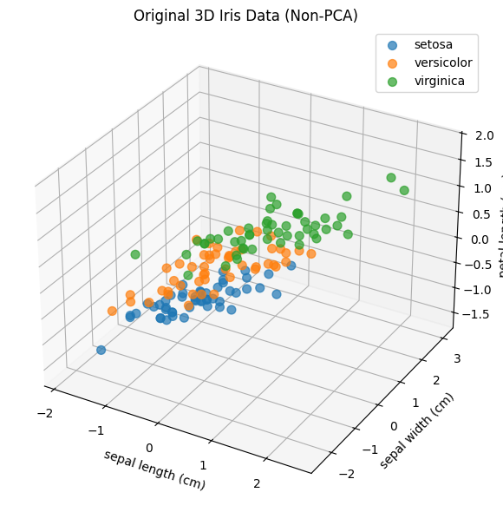
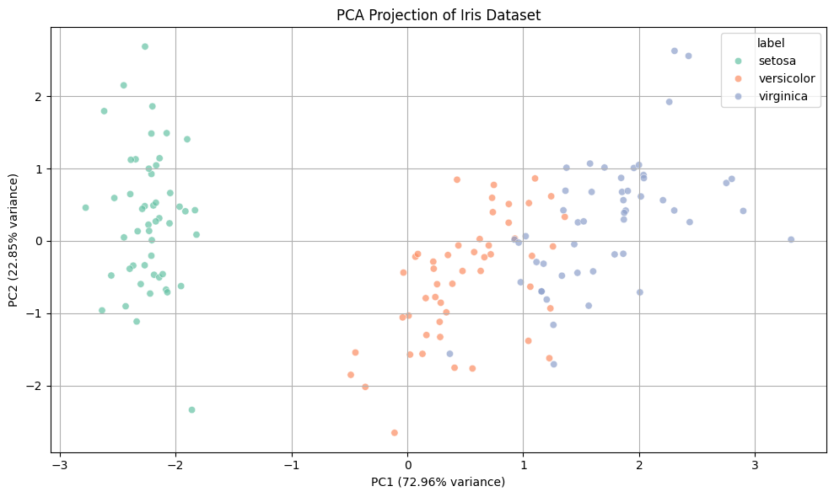
Principal Component Analysis
Principal Component Analysis is a dimensionality reduction technique used in unsupervised machine learning to transform a dataset with many variables into a smaller set that still contains most of the essential information. PCA is a feature extraction method which instead of selecting the new features, creates new features that are uncorrelated capturing most variance in original data often fewer than original features

Slide 15
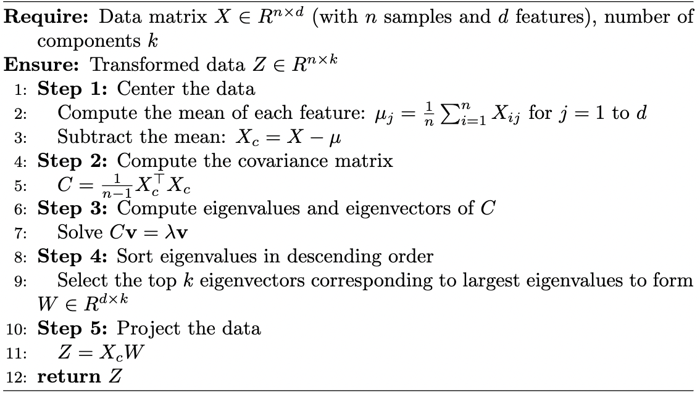
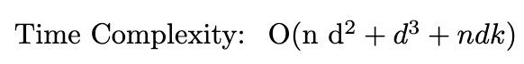
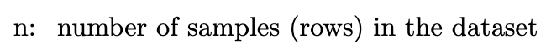
Principal Component Analysis
Pseudocode

Slide 16
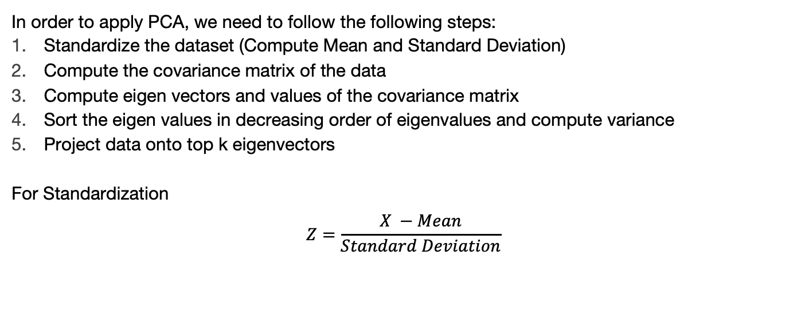
How PCA works?
In order to apply PCA, we need to follow the following steps:
Standardize the dataset (Compute Mean and Standard Deviation)
Compute the covariance matrix of the data
Compute eigen vectors and values of the covariance matrix
Sort the eigen values in decreasing order of eigenvalues and compute variance
Project data onto top k eigenvectors
For Standardization
$$Z=\frac{X −Mean}{Standard Deviation}$$

Slide 17
PCA into action
House Price Prediction Dataset:
ID | Rooms | Area | Bathrooms | Age | Price
1 | 3 | 1500 | 2 | 10 | 250000
2 | 4 | 1800 | 3 | 5 | 320000
3 | 2 | 1200 | 1 | 20 | 180000
4 | 5 | 2100 | 3 | 2 | 400000
5 | 3 | 1600 | 2 | 8 | 270000
6 | 4 | 1900 | 3 | 6 | 330000
7 | 5 | 1100 | 1 | 25 | 170000
Features | Mean | Standard Deviation
Rooms | 3.29 | 1.11
Area | 1600 | 357.77
Bathroom | 2.14 | 0.90
Age | 10.86 | 7.96

Slide 18
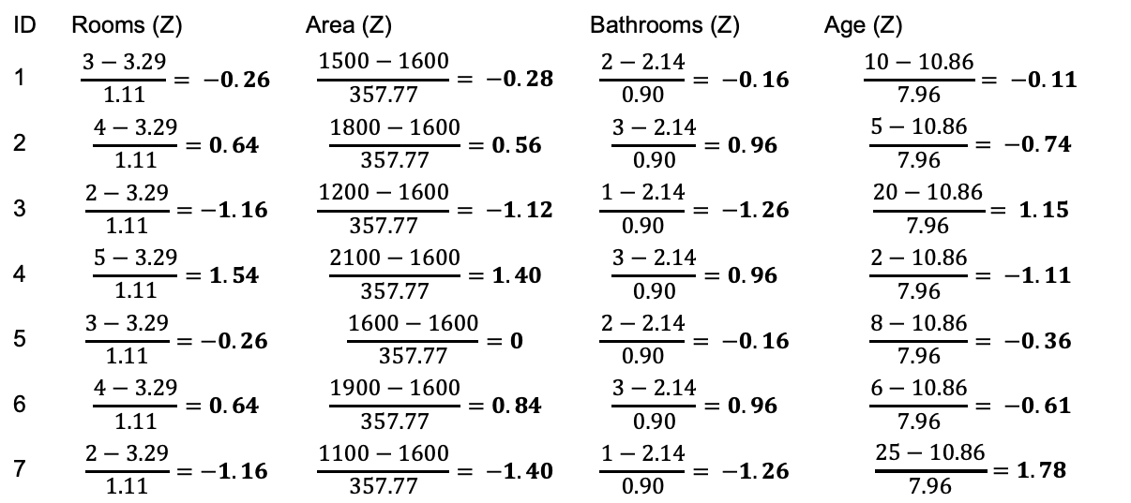
Step 1 Standardize the dataset (Compute Mean and Standard Deviation)
ID | Rooms (Z) | Area (Z) | Bathrooms (Z) | Age (Z)
1 | $$\frac{3−3.29}{1.11}= −0.26$$ | $$\frac{1500−1600}{357.77}= −0.28$$ | $$\frac{2−2.14}{0.90}= −0.16$$ | $$\frac{10−10.86}{7.96}= −0.11$$
2 | $$\frac{4−3.29}{1.11}=0.64$$ | $$\frac{1800−1600}{357.77}=0.56$$ | $$\frac{3−2.14}{0.90}=0.96$$ | $$\frac{5−10.86}{7.96}= −0.74$$
3 | $$\frac{2−3.29}{1.11}=−1.16$$ | $$\frac{1200−1600}{357.77}= −1.12$$ | $$\frac{1−2.14}{0.90}= −1.26$$ | $$\frac{20−10.86}{7.96}= 1.15$$
4 | $$\frac{5−3.29}{1.11}=1.54$$ | $$\frac{2100−1600}{357.77}=1.40$$ | $$\frac{3−2.14}{0.90}=0.96$$ | $$\frac{2−10.86}{7.96}= −1.11$$
5 | $$\frac{3−3.29}{1.11}=−0.26$$ | $$\frac{1600−1600}{357.77}=0$$ | $$\frac{2−2.14}{0.90}= −0.16$$ | $$\frac{8−10.86}{7.96}= −0.36$$
6 | $$\frac{4−3.29}{1.11}=0.64$$ | $$\frac{1900−1600}{357.77}=0.84$$ | $$\frac{3−2.14}{0.90}=0.96$$ | $$\frac{6−10.86}{7.96}= −0.61$$
7 | $$\frac{2−3.29}{1.11}=−1.16$$ | $$\frac{1100−1600}{357.77}= −1.40$$ | $$\frac{1−2.14}{0.90}= −1.26$$ | $$\frac{25−10.86}{7.96}=1.78$$
We denote this as Z Matrix and n = 7

Slide 19
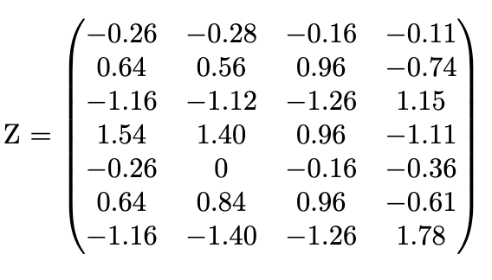
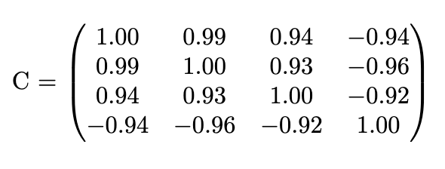
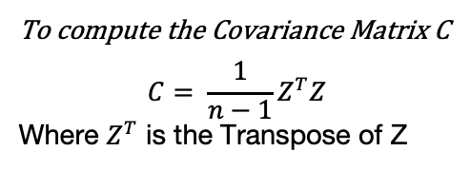
Step 2: Computing the Covariance Matrix
To compute the Covariance Matrix C
$$C= \frac{1}{n−1}Z^{T}Z$$
Where $Z^{T}$ is the Transpose of Z
Because the data is standardized, diagonal entries ≈ 1.

Slide 20
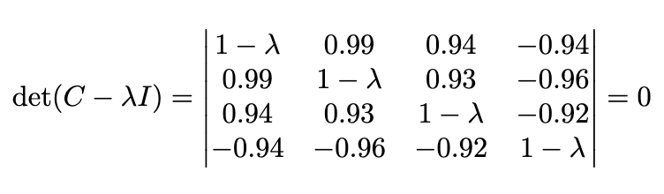
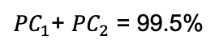
Step 3: Finding the Eigen Values and Vectors
To find the Eigen Values
Upon Solving
​ 𝛌 =3.88, 𝛌 = 0.10, 𝛌 = 0.01, 𝛌 ​=0.01
Total Variance = 3.88 + 0.10 + 0.01 + 0.01
${PC}_{1}$+ ${PC}_{2}$ = 99.5%
∴ Optimal Value of k = 2

Slide 21
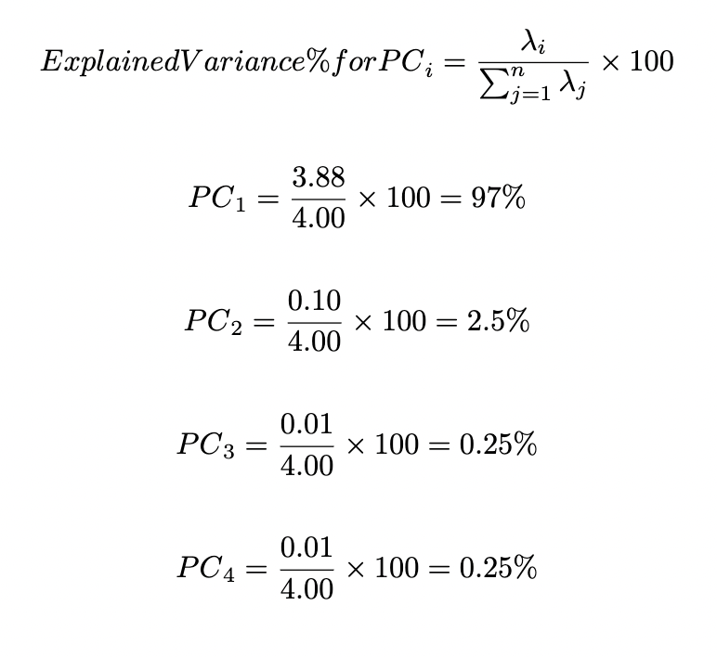
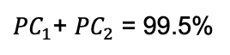
Sort the Eigen Values
${PC}_{1}$+ ${PC}_{2}$ = 99.5%
∴ Optimal Value of k = 2

Slide 22
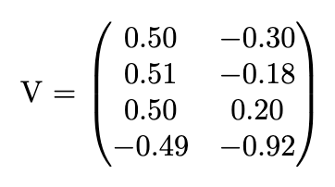
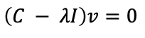
Eigen Vectors
Computing the eigen Vectors for ​ 𝛌 =3.88, 𝛌 = 0.10
​
𝛌 =3.88 𝛌 = 0.10
To find eigen vectors
$$\left(C − λI\right)v=0$$

Slide 23
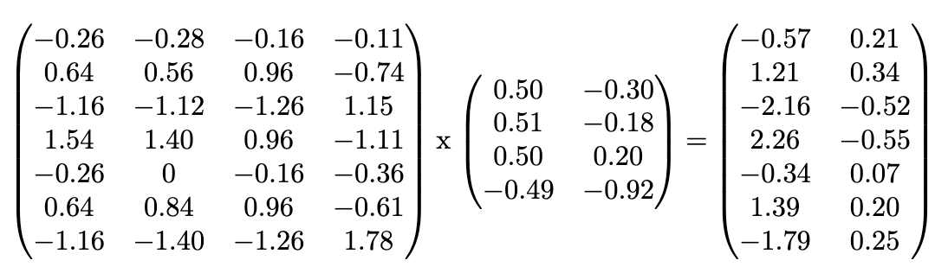
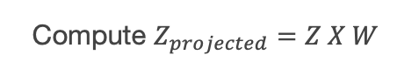
Final Dataset after PCA
Compute $Z_{projected}=Z X W$

Slide 24
Use cases of PCA
Reducing features before applying ML models
Visualizing high dimensional data in 2D or 3D
Noise Reduction in data
Image compression

Slide 25
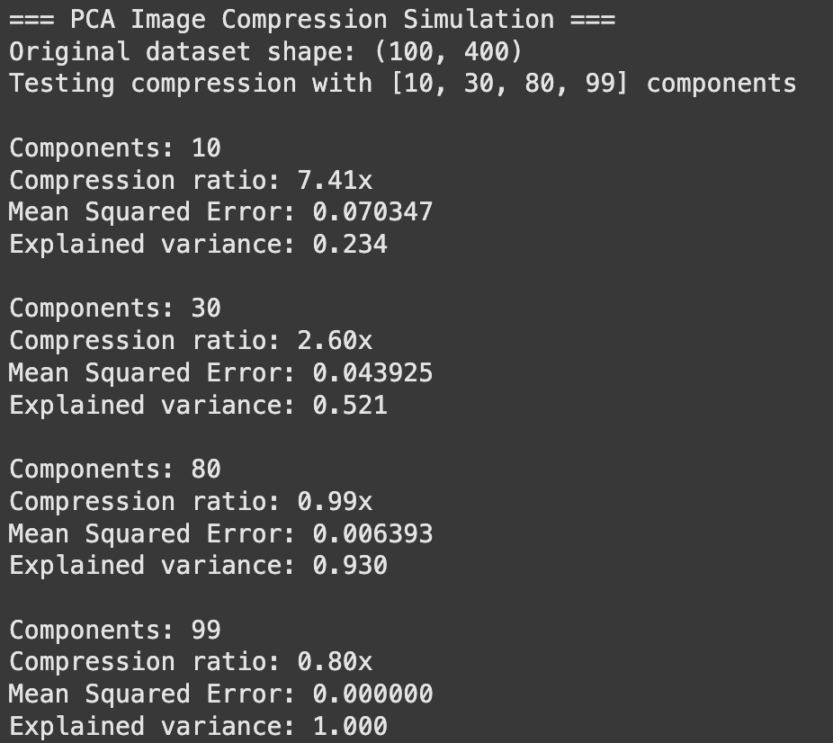
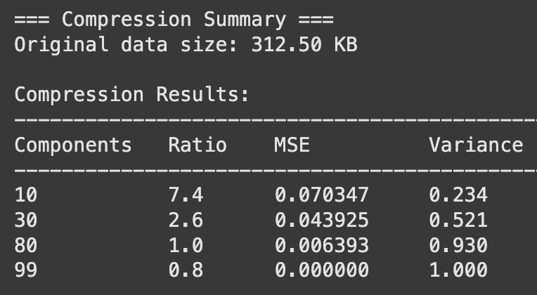
Application (Image Compression Simulation)

Slide 26
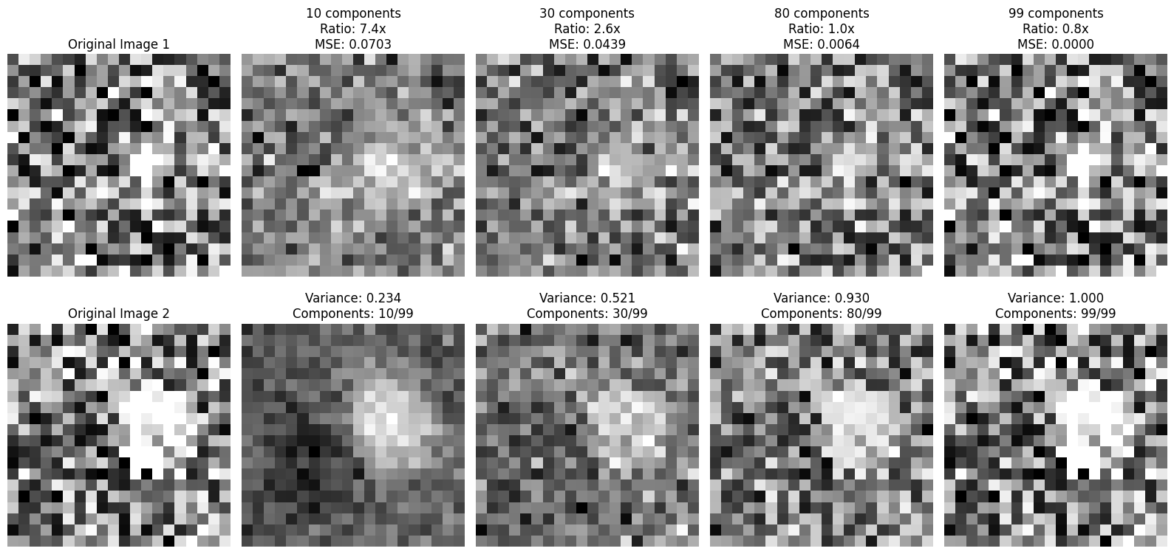
Application (Image Compression Simulation)

Slide 27
Fisher discriminant
The Fisher discriminant, also known as Fisher's Linear Discriminant (FLD), is a dimensionality reduction technique primarily used in supervised classification problems. It aims to find a linear combination of features that best separates two or more classes of data.
FLD reduces the dimensionality of the data by projecting it onto the direction(s) that best discriminate between the classes. For a two-class problem, the data is typically reduced to one dimension along the optimal projection line. For problems with C classes, the data can be projected onto a subspace of at most C−1 dimensions.
Steps
Calculate the Mean Vectors for Each Class
Calculate the Within-Class Scatter Matrix
Calculate the Between-Class Scatter Matrix
Find the Optimal Projection Vector
Project the Data onto the New Lower-Dimensional Space
Classification

Slide 28
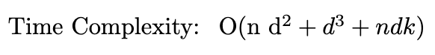
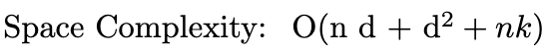
Fisher discriminant
Pseudocode

Slide 29
Fisher discriminant
Consider the following dataset
Experience | Age | Salary | Class
2 | 25 | 40000 | Junior
10 | 35 | 80000 | Senior
5 | 30 | 60000 | Junior
3 | 26 | 42000 | Junior
12 | 40 | 90000 | Senior

Slide 30
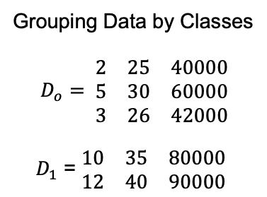
Step 1: Calculate the Mean Vectors for Each Class
Converting all data to numerical
Experience | Age | Salary | Class
2 | 25 | 40000 | 0
10 | 35 | 80000 | 1
5 | 30 | 60000 | 0
3 | 26 | 42000 | 0
12 | 40 | 90000 | 1
Grouping Data by Classes
$$D_{o}= \begin{matrix}2 & 25 & 40000 \\ 5 & 30 & 60000 \\ 3 & 26 & 42000\end{matrix}$$
${ D}_{1}$ = $\begin{matrix}10 & 35 & 80000 \\ 12 & 40 & 90000\end{matrix}$

Slide 31
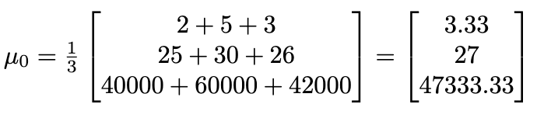
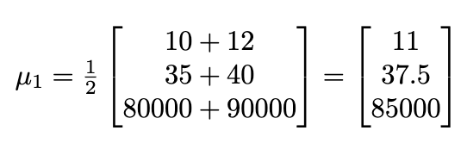
Step 1: Calculate the Mean Vectors for Each Class
Computing Mean Classes

Slide 32
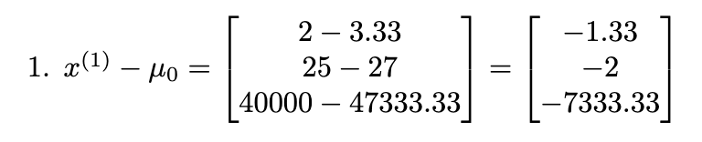
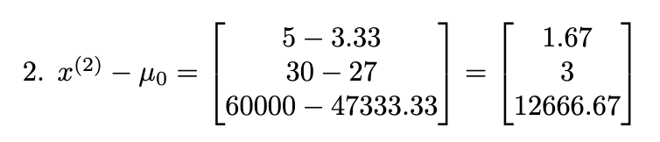
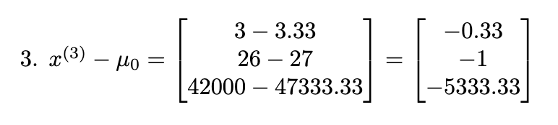
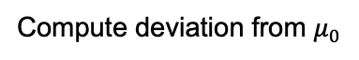
Step 2: Calculate the Within-Class Scatter Matrix
Computing centered vectors and then outer products
For Class 0
Compute deviation from $μ_{0}$

Slide 33
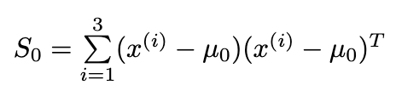
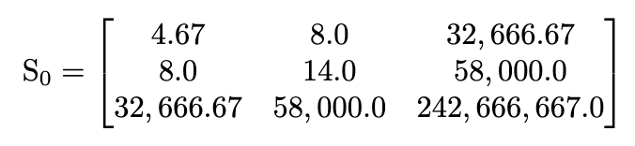
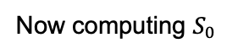
Step 2: Calculate the Within-Class Scatter Matrix
Computing centered vectors and then outer products
For Class 0
Now computing $S_{0}$

Slide 34
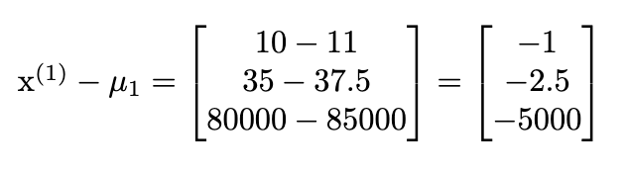
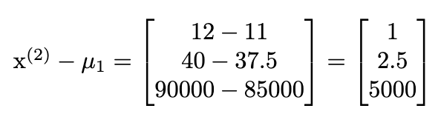
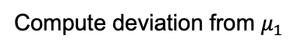
Step 2: Calculate the Within-Class Scatter Matrix
Computing centered vectors and then outer products
For Class 1
Compute deviation from $μ_{1}$

Slide 35
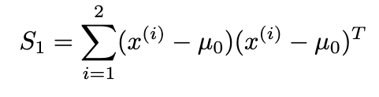
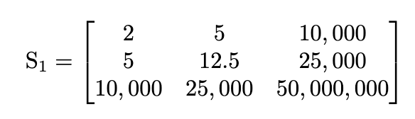
Step 2: Calculate the Within-Class Scatter Matrix
Computing centered vectors and then outer products
For Class 1
Now computing

Slide 36
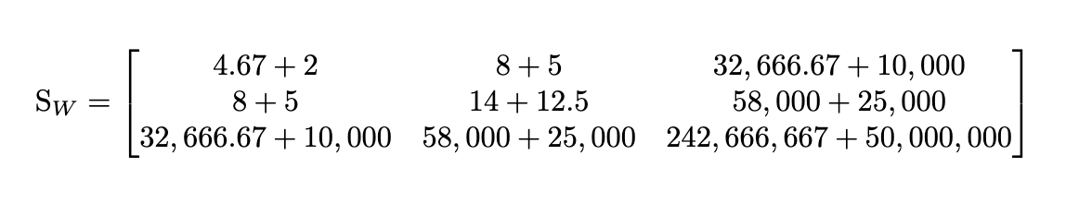
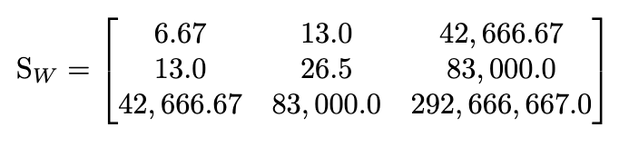
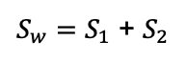
Step 2: Calculate the Within-Class Scatter Matrix
$S_{w}=S_{1}$ + $S_{2}$

Slide 37
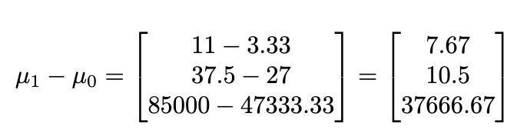
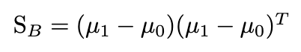
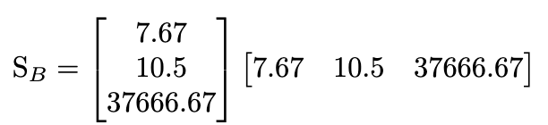
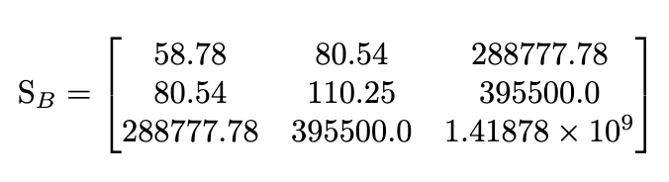
Step 3: Calculate the Between-Class Scatter Matrix
After computing

Slide 38



Step 4: Optimal Projection Vector
In Fisher’s Linear Discriminant Analysis (FDA), the optimal projection vector is computed as:
We have

Slide 39



Step 4: Optimal Projection Vector
In Fisher’s Linear Discriminant Analysis (FDA), the optimal projection vector is computed as:
Now computing w*

Slide 40



Step 5: Project Data Points Using Optimal Projection Vector
To project the data points for obtaining the threshold values

Slide 41




Step 5: Project Data Points Using Optimal Projection Vector
To project the data points for obtaining the threshold values
$$Z_{threshold}= \frac{−417.01+(−963.48)}{2}$$
= −690.25

Slide 42


Step 5: Project Data Points Using Optimal Projection Vector
Projecting the entire matrix

Slide 43
Use cases of FDA
Face Recognition (e.g., Fisherfaces)
Medical Diagnosis (disease classification)
Speech and Speaker Recognition
Marketing and Customer Segmentation
Finance and Credit Scoring
Handwriting Recognition
Bioinformatics (gene expression classification)
Fault Detection in Engineering Systems
Document Classification and Text Mining

Slide 44


Application: Medical Diagnosis (disease classification)

Slide 45



Application: Medical Diagnosis (disease classification)

Slide 46
Summary

Slide 47
Summary
01
Curse of Dimensionality
02
Dimensionality Reduction Techniques
03
PCA and FDA

